Slide 1
Chapter 8
Logistic Regression

Slide 2
Logistic Regression
So far: response variable – quantitative
Chapter 8: response variable – categorical
X = HSGPA, Y = Accepted to TAMU
X = Amount of credit card transaction, Y = Fraudulent (Y/N)
Ideally such responses follow a binomial distribution in which case the appropriate model is a logistic regression model.

Slide 3
Logistic Regression
 | Response Variable Quantitative | Response Variable Categorical
Explanatory Variable Quantitative | Regression | Logistic Regression
Explanatory Variable Categorical | ANOVA | χ² Tests
Explanatory Variables Categorical & Quantitative | ANCOVA | Logistic Regression

Slide 4
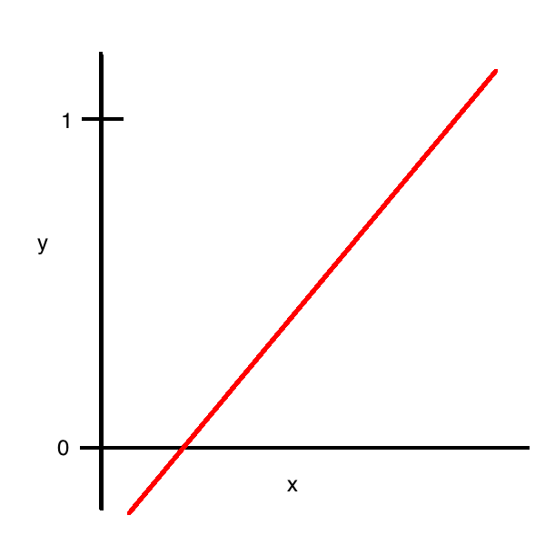
Logistic Regression
Why not use our usual linear regression methods, creating a dummy variable for y, and fitting a least squares regression line between x and y?

Slide 5
Logistic Regression
How do we turn a binary variable into something continuous?
What about using proportion of successes?
What about using odds of success?

Slide 6
From Probability to Log Odds

Slide 7
From Probability to Log Odds
Probability | 0.1 | 0.25 | 0.5 | 0.75 | 0.9
Odds | 0.111 | 0.333 | 1 | 3 | 9
Log(Odds) | -2.2 | -1.1 | 0 | 1.1 | 2.2

Slide 8
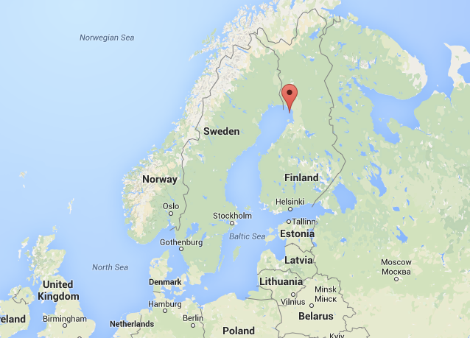
Example: Bird Extinctions on Islands

Slide 9
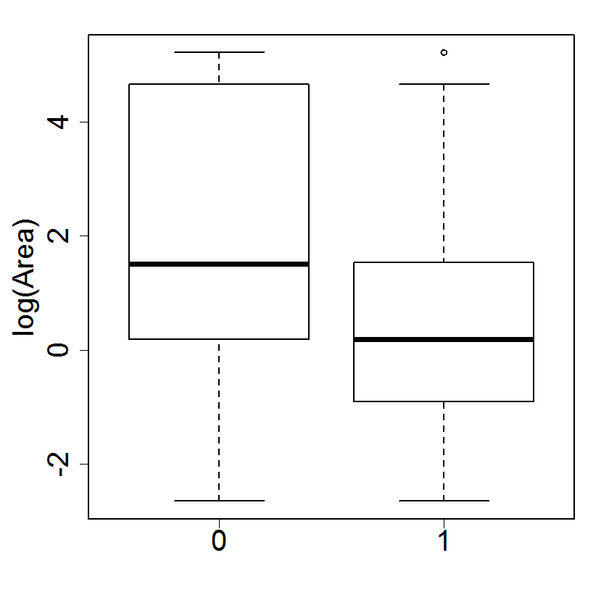
Example: Bird Extinctions on Islands

Slide 10
Example: Bird Extinctions on Islands
X = Area, Y = 1 if extinct, 0 if not extinct
First category in alphabetical order = failure, or 0 = failure.
Coefficients:
Estimate Std. Error z value Pr(>|z|)
(Intercept) -1.19620 0.11845 -10.099 < 2e-16 ***
xnew -0.29710 0.05485 -5.416 6.08e-08 ***

Slide 11




Example: Bird Extinctions on Islands
If an island has 50 km², what is the estimated probability that a species will go extinct there?
The estimated probability that a species will go extinct on an island with 50 km² is 0.086.

Slide 12
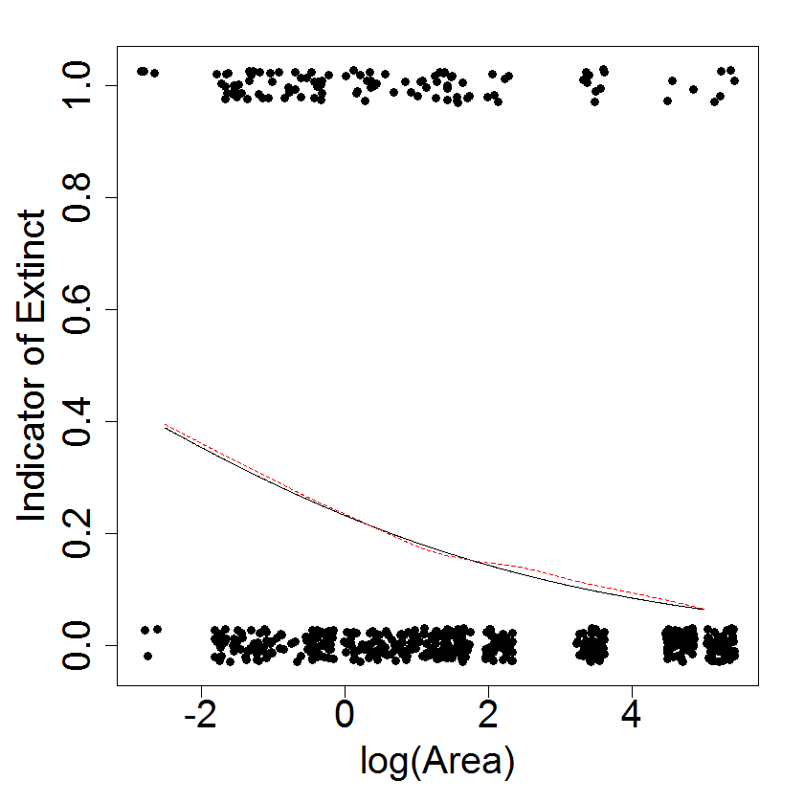
Example: Bird Extinctions on Islands

Slide 13
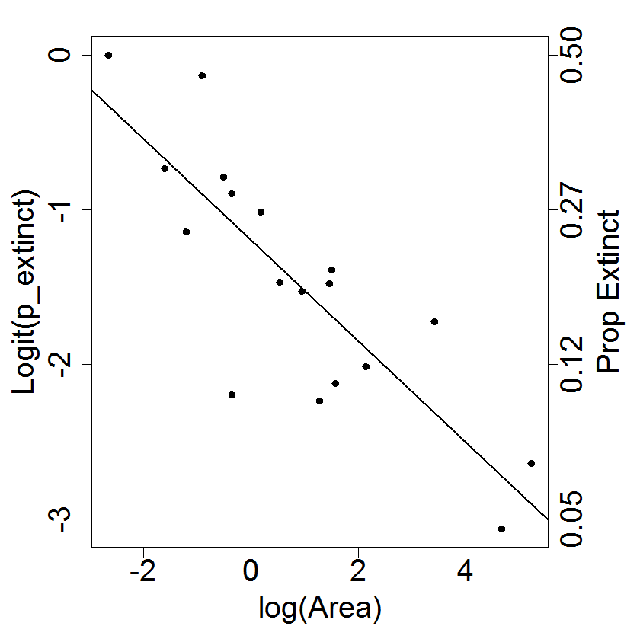
Example: Bird Extinctions on Islands

Slide 14
How β₀ Affects Model
β₀ as labeled,
β₁ = 1
β₀ determines the vertical location of the curve.
θ = 0.5 when x = -β₀/β₁

Slide 15
How β₁ Affects Model
β₀ = 0.5,
β₁ as labeled
The larger |β₁|, the steeper the slope .
If β₁ > 0, the model has a positive slope.
At θ = 0.5, the slope of the model predicting probabilities is β₁/4.

Slide 16
Interpret Slope
A study on cereal attempted to predict the probability that a cereal would be classified as a children’s cereal rather than adults’ cereal, based on its grams of sugar per serving.

Slide 17
Interpret Slope
Usually, we interpret the slope as the predicted amount of increase or decrease in y for a one-unit increase in x.
What happens to the model when x increases by one unit? Compare the above to:
So the odds of being a children’s cereal are predicted to be multiplied by exp(0.158) = 1.17 when one gram of sugar is added to the cereal. That is, the odds increase by a multiplicative factor of 1.17.

Slide 18
Ratios
Ratios larger than 1 have a larger numerator; ratios smaller than 1 have a larger denominator.
The ratio of male to female students at A&M (Fall semester 2014 data) is 29,605 / 26,902 = 1.10. That is, there are about 10% more men than women at A&M.
The ratio of female to male students is 0.91; there are about 91% as many women as men.
As with odds, ratios aren’t symmetric.

Slide 19
What is an Odds Ratio? Physicians Health Study
 | Aspirin | Placebo | Total
Heart Attack | 139 | 239 | 378
No HA | 54,421 | 54,117 | 108,538
Total | 54,560 | 54,356 | 108,916
Define success as having a heart attack.
θ_{Aspirin} = 0.0025, θ_{Placebo} = 0.0044
Odds_{Aspirin} = 0.0026, Odds_{Placebo} = 0.0044

Slide 20
What is an Odds Ratio? Physicians Health Study
Interpret: Our model predicts the odds of having a heart attack to be about half as high if male physicians take an aspirin a day than if they don’t.
Notice the interpretation of a multiplicative effect rather than an additive effect: The odds of having a heart attack are multiplied by about ½ when taking aspirin.

Slide 21

Odds Ratios
In a study of a disease in humans, researchers used the independent variable ethnicity to predict probability of the disease. The model was:
The variable encoding scheme was as follows:
 | x1 | x2 | x3
White Non-Hispanic | 0 | 0 | 0
Black | 1 | 0 | 0
Hispanic | 0 | 1 | 0
Other | 0 | 0 | 1

Slide 22
Odds Ratios
Below is partial output from the model:
Coefficients:
Estimate Std. Error z value Pr(>|z|)
(Intercept) -1.3863 0.5000 -2.773 0.00556
x1 2.0794 0.6325 3.288 0.00101
X2 1.7918 0.6455 2.776 0.00551
X3 1.3863 0.6708 2.067 0.03878
Report a 95% confidence interval for the odds ratio comparing Hispanic to White.
What is the odds ratio for comparing Hispanic to Black?

Slide 23
8.1: A sample of size m_{i} at every observed value of x_{i}
Binomial distribution:
There are m identical trials
Each trial has only one of two outcomes (Success or Failure)
The probability of success θ is the same for all trials
Trials are independent
Let Y = number of successes in m trials of a binomial process. Then Y is binomial with parameters m and θ. We write:
The probability that there are j successes in m trials (j = 0, 1, …, m) is given by:

Slide 24
8.1: A sample of size m_{i} at every observed value of x_{i}
Mean and variance of Y:
In Section 8.1, we assume we have one predictor variable x with mi measurements at each level of x. In this case:
Notice that we write the probability of success as a function of the value of the predictor variable x.

Slide 25
8.1: A sample of size m_{i} at every observed value of x_{i}
Why not use proportions instead of odds?
Proportion of successes =
It could be the response since it is an unbiased estimate of θ(x_{i}) and it varies between 0 and 1.
BUT: Calculate the mean and variance of the sample proportion:
Variance is not constant! We need our log odds model.

Slide 26
Relationship between θ and θ(1 – θ)

Slide 27
Finding Parameter Estimates
The Likelihood function, denoted L, is the probability of the data, regarded as a function of the unknown parameters with the data values fixed. (Remember when we used least squares, we modeled the sums of squares as a function of the parameters with the data held fixed for regular regression.)¹
We rearrange what is fixed and what is considered random to think of likelihood as the likelihood of that value being the parameter, given the data that we have currently.
1 Stat 2: Building Models for a World of Data. Cannon, Ann R. et al. Freeman (2013)

Slide 28
Finding Parameter Estimates
The parameters for the logistic regression model are found by maximizing the log-likelihood. This is equivalent to minimizing the deviance, -2 log L.
For linear regression models, minimizing RSS had closed form solutions; for logistic regression models, we need an iterative method to find estimates such as Newton-Raphson or iteratively reweighted least squares.

Slide 29
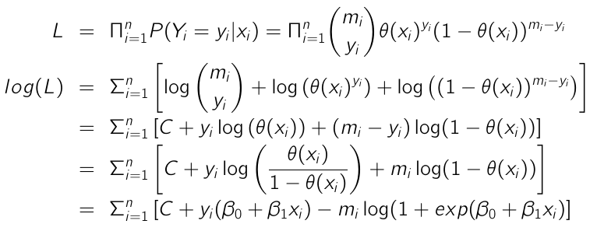
Likelihood

Slide 30
Hypothesis Tests & Confidence Intervals
The standard error of the parameter estimates is based on the information statistic, the second derivative of the log likelihood.
Estimate Std. Error z value Pr(>|z|)
(Intercept) -1.19620 0.11845 -10.099 < 2e-16 ***
xnew -0.29710 0.05485 -5.416 6.08e-08 ***
Test whether the area of an island is associated with whether a species goes extinct. (Wald test: note z, not t!)

Slide 31
Hypothesis Tests & Confidence Intervals
A 95% confidence interval for the parameter β₁ is:
-0.297 ± 1.96 (0.055)
(-0.405, -0.190)
exp(-0.405) = 0.67
exp(-0.190) = 0.83
Interpretation: I am 95% confident that when log land area increases by 1, the odds that a species goes extinct on that island are multiplied by between 0.67 and 0.83 (the odds decrease).

Slide 32
Deviance
In linear models, we measure how well our model works in part by how close the data are to the model. The concept of residual sums of squares is replaced by deviance for logistic regression.
Deviance measures the difference between the log likelihood from the saturated model (S) and the log likelihood from our model (M). The saturated model is one with a separate proportion of successes for every value of x_{i}; that is,

Slide 33
Deviance
Island | Area | SpeciesRisk | Ext | Saturated: y_{i}/m_{i} | Logistic Model: θ-hat
Ulkokrunni | 185.8 | 75 | 5 | 0.067 | 0.060
Maakrunni | 105.8 | 67 | 3 | 0.045 | 0.070
Ristikari | 30.7 | 66 | 10 | 0.152 | 0.099
Isonkivenletto | 8.5 | 51 | 6 | 0.118 | 0.138

Slide 34
Deviance
When each m_{i} is large enough, the deviance statistic can be used as a chi-squared goodness-of-fit test for the logistic regression model.
We wanted residual sums of squares to be small because we wanted the model to fit the data well. We also want deviance to be small because we want the model to fit the data well. If deviance is large, it means the saturated model has a very different fit to the data from our model of interest.
Ho: The logistic regression model is appropriate.
Ha: The logistic regression model is inappropriate.
G² has the χ² distribution with n – p – 1 degrees of freedom, where n is the number of binomial samples, not the total sample size!
Beware sample sizes that are too large.

Slide 35
Deviance
The model summary output gives:
Null deviance: 45.338 on 17 degrees of freedom
Residual deviance: 12.062 on 16 degrees of freedom
The p-value is found by P(G² > 12.062) from a chi-squared distribution with 18 – 1 – 1 = 16 degrees of freedom: 0.74.

Slide 36
Deviance
We can also use deviance to test whether two nested models are significantly different. For example, we could test whether our model is equivalent to the null model:
H₀: β₁ = 0 vs. H_{a}: β₁ ≠ 0
The difference between the deviances for the two models is compared to a χ² distribution with the difference between the degrees of freedoms for the two models.
This doesn’t give the same result in general as the Wald z-test for whether β₁ = 0.

Slide 37
Deviance
Null deviance: 45.338 on 17 degrees of freedom
Residual deviance: 12.062 on 16 degrees of freedom
45.338 – 12.062 = 33.276, df = 17 – 16 = 1
p-value < 0.0001
We have strong evidence that log area of an island is somewhat associated with whether a species goes extinct.
Notice that the p-value for the Wald test is not the same as that of the deviance test.

Slide 38


Deviance: R² for logistic regression
Recall that for linear regression:
Since the deviance is a generalization of the residual sum of squares in linear regression, one version of R² for logistic regression is:
So for the cereal data, R² = 1 – 12.062 / 45.338 = 0.73.
This still has the issue of increasing when we add useless predictors to the model.

Slide 39
Pearson goodness-of-fit statistic
Alternative measure of deviance: Pearson χ² statistic
Same degrees of freedom as deviance: df = n – p – 1.
Same requirement: the statistic has the χ² distribution as long as each of the m_{i} are large enough. If this is true, G² and χ² are similar; we prefer G² if they yield different conclusions.¹
McCullagh & Nelder (1989) p. 398: Distributional properties for deviance residuals are closer to the residuals from a Gaussian linear regression model.

Slide 40
Residuals for Logistic Regression
Three Types of Residuals:
Response residuals
Pearson Residuals
Deviance Residuals

Slide 41
Response Residuals
Response residuals are the difference between the observed and the fitted proportions:
where is the i^{th} fitted value from the logistic regression model.
The variance of y_{i}/m_{i} is not constant, so response residuals are difficult to interpret in practice.

Slide 42
Pearson Residuals
The problem of nonconstant variance is overcome by Pearson residuals, the square root of the individual contributions to the Pearson χ² statistic.

Slide 43
Standardized Pearson Residuals
Pearson Residuals still don’t account for the variance of the model estimate , so we correct for that:

Slide 44
Deviance Residuals
Deviance residuals are to the deviance statistic G2 as Pearson residuals are to the χ² Pearson statistic.
Standardized deviance residuals are defined to be:

Slide 45
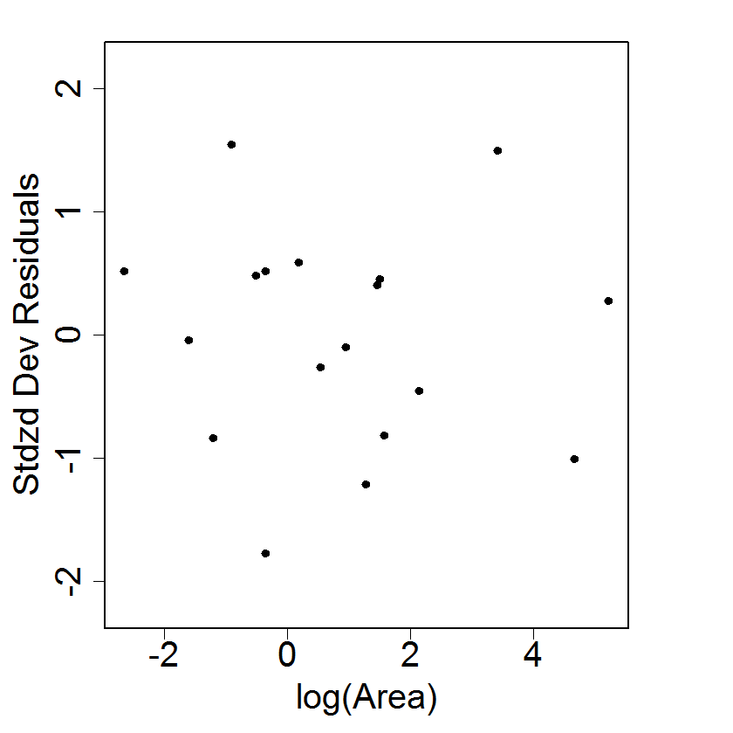
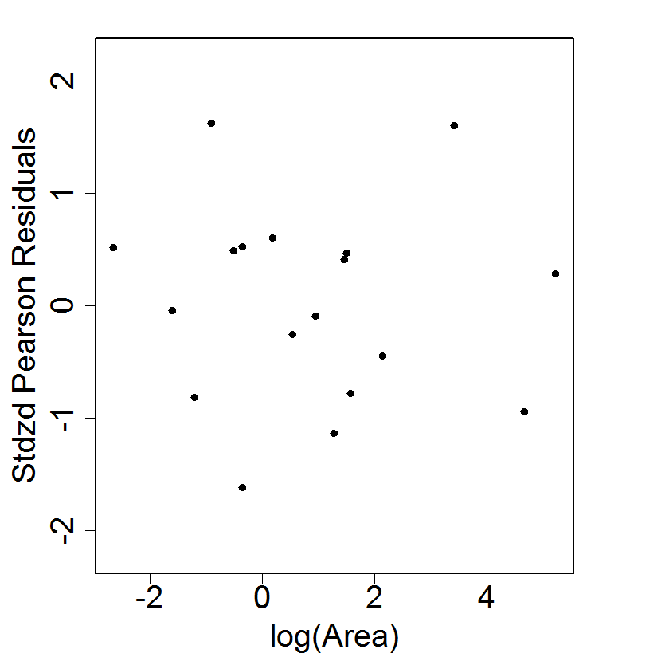
Which residuals are best?
Pearson residuals are most popular, but deviance residuals are actually preferred; their distribution is closer to that of least squares residuals.

Slide 46
8.2 Binary Logistic Regression
It is more common that we have only one observation at many values of the predictor variable. (E.g. many predictors!) Such data are called binary.
Goodness of fit measures are problematic and plots of residuals are difficult to interpret. (Two U-shaped curves!)

Slide 47
Compare Fits
If we fit data with the assumption that all the m_{i} equal 1, the parameter estimates, standard deviations, Wald z-scores, and p-values are all equivalent.
The difference is in the deviance:
Binomial Fit:
Null deviance: 45.338 on 17 degrees of freedom
Residual deviance: 12.062 on 16 degrees of freedom
Binary Fit:
Null deviance: 578.01 on 631 degrees of freedom
Residual deviance: 544.74 on 630 degrees of freedom
AIC values are also different.

Slide 48
Binary Deviance
In the case that m_{i} = 1, the log likelihood function is:
So for the saturated model, the log-likelihood function is:
If y_{i} = 0:
If y_{i} = 1:

Slide 49
Binary Deviance
So in the case where mi = 1, the deviance between the saturated model and the current model only depends on log(L_{M}).
Deviance doesn’t provide an assessment of the goodness-of-fit of the model! It also doesn’t have a χ² distribution.
However, we can use deviance to compare two models; the difference between two deviances still has an approximate χ² distribution.

Slide 50
Binary Residuals

Slide 51
Binary Residuals
Residual plots are problematic when the data are binary.
Instead of examining residual plots, compare the fitted model to a nonparametric fit.

Slide 52
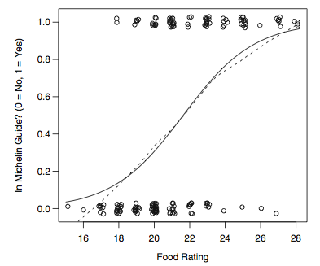
Binary Residuals

Slide 53
Transforming Predictors for Binary Data
Why transform predictor variables?
Quick review: Suppose 30% of Dalmatians are deaf. If I randomly select 1 Dalmatian, how many are expected to be deaf?

Slide 54
Transforming Predictors for Binary Data: Binary Predictor
First suppose the predictor is a dummy variable:
Take logs of both sides:

Slide 55
Transforming Predictors for Binary Data: Continuous Predictor
When X is binary:
Similarly, when X is continuous:
We ignore the first term either way when discussing transformations of X.

Slide 56
Transforming Predictors for Binary Data: Normal Predictor
When f(x|Y = j), j = 0, 1, is a normal density (possibly with two different means and variances):
Then that piece of the log odds we were worried about:

Slide 57
Transforming Predictors for Binary Data: Normal Predictor
Conclusions:
When x is normal, log odds are a quadratic function of x.
When the variances are equal, the log odds is a linear function of x with:

Slide 58
Transforming Predictors for Binary Data: Multivariate Normal
After some more math… when we have p predictors that are multivariate normal, with different covariance matrices for Y= 0 and Y = 1, then the log odds are a function of x_{i}, x_{i}², and x_{i}x_{j} (i, j = 1, …, p; i ≠ j).
If the variance of x_{i} is different for Y = 0 and Y = 1, add a quadratic term in x_{i}.
If the regression of x_{i} on x_{j} has a different slope for Y = 0 and Y = 1, add the interaction x_{i}x_{j}.

Slide 59
Interactions
Recall: an interaction between x_{i} and x_{j} means the relationship between x_{i} and y is different depending on the value of x_{j}.
That means the relationship between x_{i} and x_{j} will be different depending on the value of y.
Plot x_{i} and x_{j}, fitting separate slopes for the values of y (0 and 1). The farther apart the slopes, the more important it is to fit an interaction.

Slide 60
Transforming Predictors for Binary Data: Poisson Predictor
Distribution of X (possibly with different means again):
Starting over again with the piece of the log odds that varies with X:
Again, we end up with log odds being a linear function of x.

Slide 61
Marginal Model Plots
Residual plots are difficult to interpret; instead we use marginal model plots.
Same concept as for multiple linear regression: compare nonparametric estimates of (for every variable x_{i}):
If they agree, we conclude that x_{i} is modeled correctly by our model. If not, then x_{i} is not modeled correctly by our model.

Slide 62
Leverage
Obtained from weighted least squares approximation to the MLEs.
Average leverage = (p+1)/n; cutoff = 2(p+1)/n.

